Slide 1

Predicting Interstate Affinity Using Machine Learning
Alden Felix, Wei-chen Huang

Slide 2
Area/Topic
Inspired by Dr. Vito D'Orazio – predicted violent conflict in Africa using machine learning models
Wanted to generalize globally
Predict inter-state affinity with machine learning using political, social, and economic data

Slide 3
Methods
Dependent Variable
Continuous – affinity score from coded event data: OLS
Categorical – clustering methods to create “affinity communities”: LASSO
Random Forests
Gradient Boosted Machines
Neural Networks

Slide 4

Data – dependent variable
UTD Event Data Database
  1) Phoenix_RT: Real-time data from October 2017 to today (Open Event Data Alliance)
  2) ICEWS: Integrated Crisis Early Warning System from Harvard Dataverse from January 1, 1995, to September 28, 2020
  3) Phoenix NYT: Accumulated from 1945 to 2005 (Phoenix Event Data, Cline Center
  4) Phoenix FBIS: Accumulated from 1995 to 2004 (Phoenix Event Data , Cline Center)
  5) Phoenix SWB: Accumulated from 1979 to 2015 (Phoenix Event , Cline Center.
  6) TERRIER: Accumulated from 1979 to 2015 (Temporally Extended, Regular, Reproducible International Event Records, OSF Home)

Slide 5
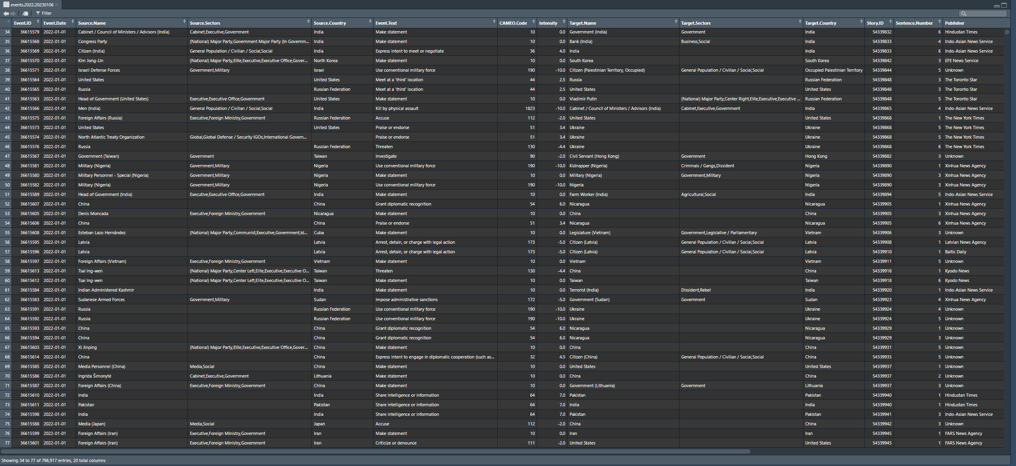

Slide 6
Data – independent variables
World Bank
  World Development Indicators
  Education Statistics
  Gender Statistics
  Health Nutrition and Population Statistics
  Doing Business (Objective measures of business regulations and their enforcement)

